Slide 1
Quantum Feature Selection
QC Final Project
Notes:
Hello everyone, today I’ll be presenting my quantum computing final project on Quantum Feature Selection.
This project explores how quantum algorithms can help solve the feature selection problem more efficiently, especially in high-dimensional datasets.

Slide 2
Table of Content
Motivation
Algorithm
Method
Results
Discussion
1
3. Motivation
Result
Benchmark Performance
Sensitivity Analysis
Importance Analysis
VQE Implementation
4
2
Algorithm
Formulation
Solver
Method
Data Preparation
Implementation
Feature Quality Analysis
VQE Implementation
3
Discussion
Key Highlights
Limitation
5
Notes:
Here’s an overview of today’s presentation.
I’ll first walk through the motivation and algorithm, then move to the implementation and experiments, followed by the results, and end with key insights and limitations.

Slide 3
Motivation
Notes:
Let me start with the motivation behind this work.

Slide 4
Motivation
Algorithm
Method
Results
Discussion
Motivation
Why Feature Selection matters ?
Problem
Why Quantum?
Reducing dimensionality improves model performance, robustness, and interpretability.
Selecting informative and non-redundant features is crucial for generalization, especially in biomedical and real-world datasets.
Classical methods often struggle with combinatorial complexity and redundancy among features.
Feature selection can be naturally formulated as a combinatorial optimization problem.
Quantum algorithms can potentially explore exponentially large search spaces more efficiently.
Object
Implement and evaluate a QUBO-based Quantum Feature Selection (QFS) framework. This work serves as a step toward understanding the feasibility and limitations of quantum-native feature selection.
Notes:
In many real-world machine learning applications, especially biomedical data, we often face high-dimensional feature spaces.
Reducing dimensionality improves model robustness and interpretability, but selecting a good subset of features is a combinatorial optimization problem.
Classical methods like greedy search or filter-based selection often struggle with redundancy and scale poorly.
In contrast, quantum algorithms are promising because they can explore large search spaces in parallel.
So in this project, I aim to implement and evaluate a QUBO-based Quantum Feature Selection framework, and explore its practical feasibility.

Slide 5
Algorithm
Mücke, S., Heese, R., Müller, S., Wolter, M., & Piatkowski, N. (2023). Feature Selection on Quantum Computers. Quantum Machine Intelligence, 5, 11. https://doi.org/10.1007/s42484-023-00099-z
Notes:
The core algorithm I used is based on the work by Mücke et al., published in Quantum Machine Intelligence in 2023.
Their method formulates feature selection as a QUBO problem, which can be solved by either classical or quantum approaches.
In this section, I’ll explain how the algorithm is formulated and how the QUBO problem is solved.

Slide 6
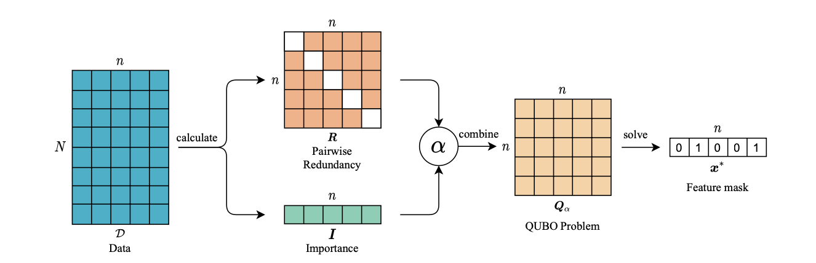

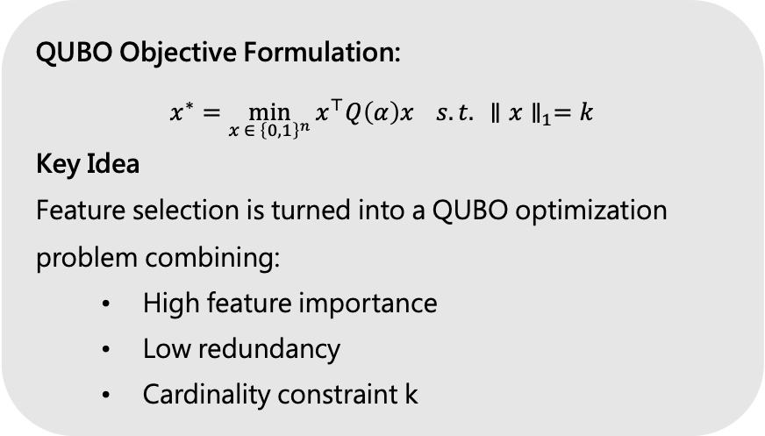
Motivation
Algorithm
Method
Results
Discussion
Algorithm - Formulation
QUBO Objective Formulation:
$$x^{∗}=\min_{x ∈ {\left\{0,1\right\}}^{n}}{x^{⊤}Q\left(α\right)x} s.t. ∥x∥_{1}=k$$
Key Idea Feature selection is turned into a QUBO optimization problem combining:
High feature importance
Low redundancy
Cardinality constraint k
Pipeline Overview
Step 1: Compute
Redundancy matrix $R∈R^{n×n}$
Importance vector $I∈R^{n}$
Step 2: Combine R and I using interpolation factor α
Construct QUBO matrix $Q(α,ε,μ)$
Step 3: Solve QUBO via quantum or classical methods
Output binary vector $x^{∗}∈ {\left\{0,1\right\}}^{n}$: selected features
Notes:
The algorithm starts by computing two matrices from the data:
A redundancy matrix R that captures pairwise correlations between features,
And an importance vector I that reflects how useful each feature is.
These two are then combined using an interpolation factor alpha, to form a QUBO matrix Q. The goal is to minimize the quadratic form xᵀQx under the constraint that exactly k features are selected.
The key idea here is to balance three objectives:
High importance (we want to select informative features),
Low redundancy (we don’t want repeated information),
And cardinality constraint, meaning we only pick exactly k features.

Slide 7
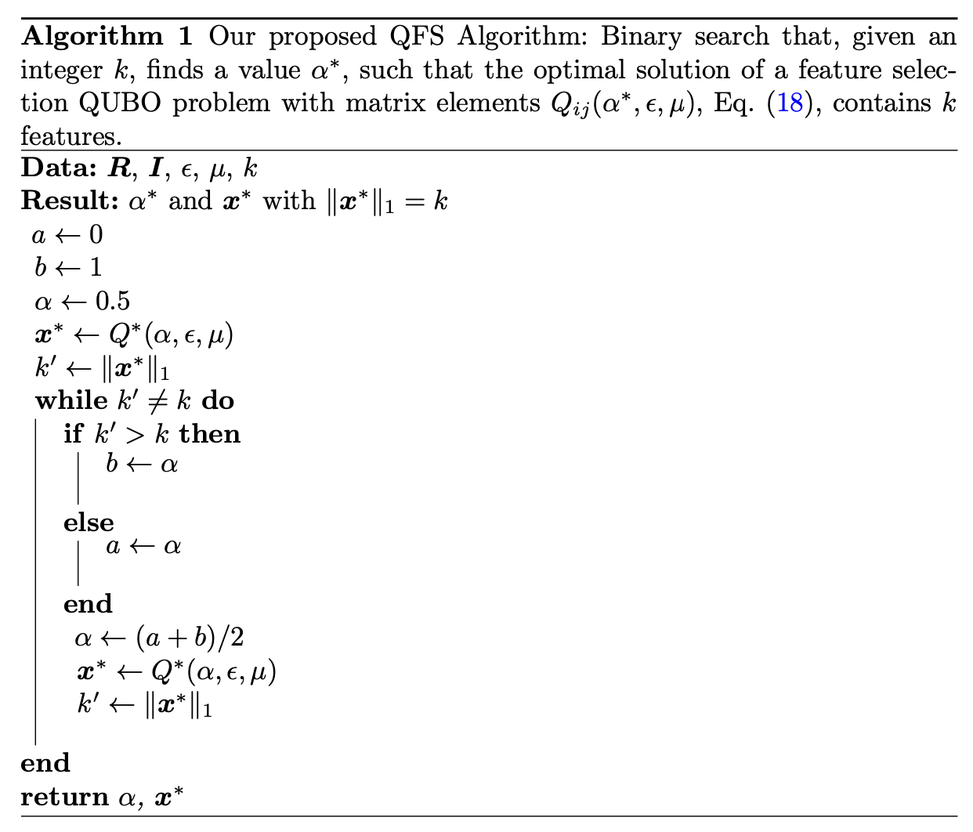

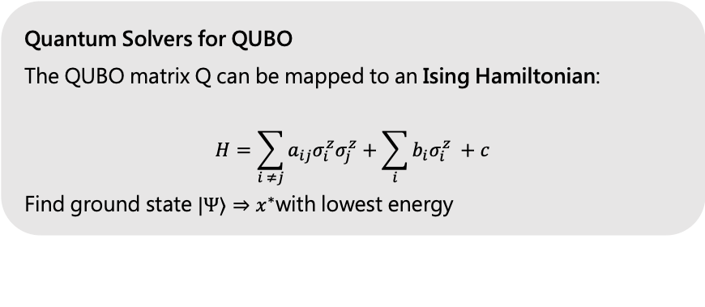
Motivation
Algorithm
Method
Results
Discussion
Algorithm - Solver
Binary Search on α
Goal: Find interpolation factor α such that the solution selects exactly k features
Procedure:
Initialize search bounds a=0, b=1
Repeat until $∥x^{∗}∥_{1}=k$
Update $α=(a+b)/2$, re-solve QUBO
Quantum Solvers for QUBO
The QUBO matrix Q can be mapped to an Ising Hamiltonian:
$$H=\sum_{i ≠j}{a_{ij}σ_{i}^{z}σ_{j}^{z}}+\sum_{i}{b_{i}σ_{i}^{z}} +c$$
Find ground state $|Ψ⟩⇒x^{∗}$with lowest energy
Notes:
Finally, we solve this QUBO using either a quantum solver or a classical approximation, and output a binary vector that represents the selected features.
One challenge is to find the right alpha value so that the solution selects exactly k features. The authors use a binary search procedure to iteratively adjust alpha.
The steps are:
Initialize a = 0, b = 1,
Repeatedly solve the QUBO and check if the solution selects k features,
If not, update alpha as (a + b)/2 and repeat.
Once we have the right alpha, we move on to solving the QUBO. The matrix Q can be mapped into an Ising Hamiltonian, allowing us to use quantum algorithms like VQE or quantum annealing.
The quantum solver then tries to find the ground state, which corresponds to the lowest-energy configuration — in our case, the optimal feature set.

Slide 8
Method
Notes:
Now I’ll walk you through the implementation and evaluation process — how I designed the experiments, handled the data, and extended the algorithm to support regression tasks.

Slide 9
Method
Motivation
Algorithm
Method
Results
Discussion
Data Preparation – Simulated Data
Simulated data constructed based on Mücke et al. (2023) to evaluate feature selection accuracy under controlled ground truth.
Regression
Classification
10 features, 4 informative (randomly selected)
Target = linear combination of informative features + noise
Feature values sampled from N(0, 1)
Ground truth informative indices available
10 features, 4 informative
Label = thresholded linear sum of informative features
Feature values sampled from N(0, 1)
Balanced binary labels (y ∈ {0, 1})
Notes:
To evaluate feature selection accuracy in a controlled setting, I first generated simulated datasets based on the original QFS paper.
For both classification and regression tasks, I used 10 features, where 4 of them were randomly assigned to be informative.
In regression, the target is a linear combination of the informative features plus some noise.
In classification, the label is determined by thresholding the linear sum.
This setup allows me to compare selected features against the known ground truth.

Slide 10
Method
Motivation
Algorithm
Method
Results
Discussion
Data Preparation – Real Data
Dataset | Type | Features | Samples | Source | Description
Breast Cancer | Classification | 30 | 569 | sklearn | Diagnosis of malignant vs benign tumors
Digits | Classification | 64 | 1,797 | sklearn | Handwritten digit recognition
Ionosphere | Classification | 34 | 351 | OpenML | Radar signal classification
Diabetes | Regression | 10 | 442 | sklearn | Predicting disease progression
California Housing | Regression | 8 | 20,640 | sklearn | Predicting median house prices in CA
Notes:
I also tested on five real-world datasets, including both classification and regression tasks. These datasets come from sklearn and OpenML, and range in complexity — from medical diagnosis to housing price prediction.
This helps to evaluate the practical performance and generalizability of the QFS method.

Slide 11
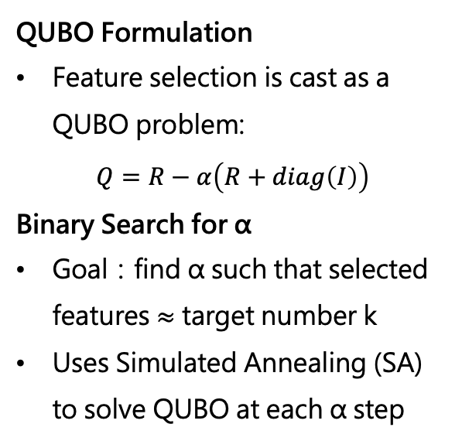
Method
Motivation
Algorithm
Method
Results
Discussion
Implementation
Algorithm Implementation
Extension for Regression
Benchmark Comparison
QUBO Formulation
Feature selection is cast as a QUBO problem:
$$Q=R−α\left(R+diag\left(I\right)\right)$$
Binary Search for α
Goal：find α such that selected features ≈ target number k
Uses Simulated Annealing (SA) to solve QUBO at each α step
Target y is discretized using quantile binning
Apply MI between binned y and features
Redundancy still uses MI between features
Compared four methods on classification and regression：
Random feature subset
All features
Top-k MI ranked features
QFS-selected features
Evaluated using：
Accuracy (classification)
MSE (regression)
Notes:
In terms of implementation, I directly formulated the QUBO as Q = R - α(R + diag(I)), and used binary search on α to control the number of selected features.
I used simulated annealing (SA) to solve the QUBO at each α step.
For regression tasks, I designed an extension of the original method. Since the original QFS method only handles classification, I proposed a simple but effective way to adapt it to regression problems. Specifically, I discretized the continuous target variable using quantile binning, and then applied mutual information (MI) between the binned target and each feature.
Redundancy was still measured between features.
For benchmarking, I compared QFS against three baselines: random features, all features, and top-k features ranked by MI.
I evaluated classification using accuracy, and regression using MSE.

Slide 12
Method
Motivation
Algorithm
Method
Results
Discussion
Feature Quality Analysis
This section evaluates the stability, predictive performance, and statistical significance of the features selected by the QFS method.
Experimental Setup
Fix target number of features k
Sweep α ∈ [0.0, 1.0] in increments of 0.1
Metrics Tracked
Accuracy (for classification tasks)
MSE (for regression tasks)
Jaccard similarity between selected feature sets (for α stability)
Importance Analysis
Sensitivity Analysis
Task Type | Test | Metric
Classification | t-test (2-sample) | p-value, Cohen’s d
Regression | Pearson correlation | correlation, p-value
All statistical tests were applied to the selected features from the best evaluation performance QFS (SA) for each dataset.
Notes:
I also evaluated the stability and quality of selected features. First, I ran a sensitivity analysis by sweeping α from 0 to 1, and observed how the number of selected features and the model performance changed.
I tracked accuracy for classification and MSE for regression across different α values. Then, I performed importance analysis using statistical tests: t-tests for classification tasks and Pearson correlation for regression. This helped assess whether the selected features were actually meaningful.

Slide 13
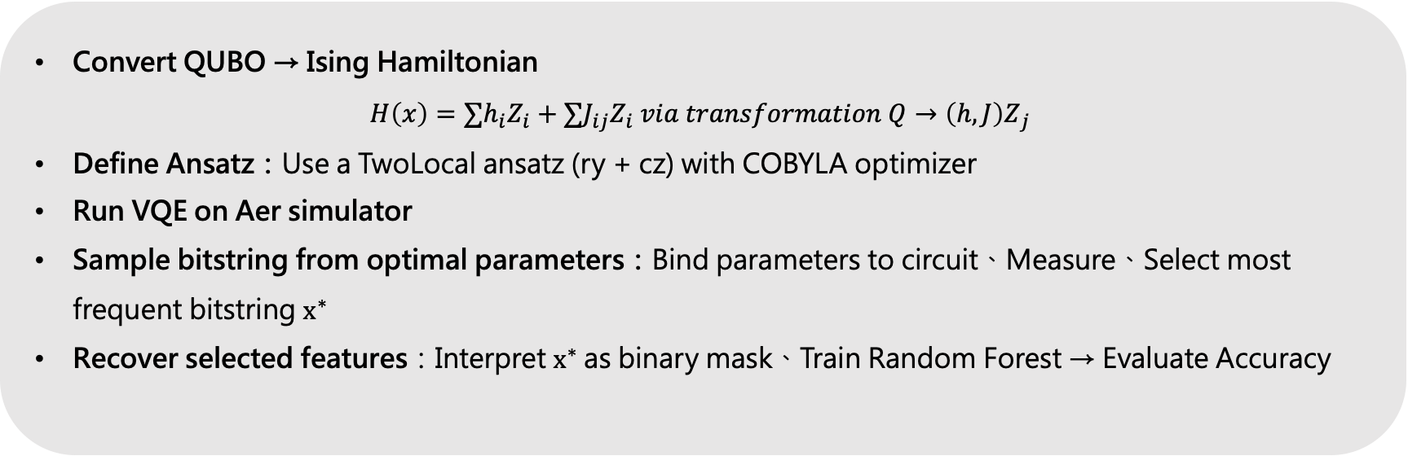
Motivation
Algorithm
Method
Results
Discussion
VQE Implementation
We implemented a quantum solution to the QUBO-based feature selection problem using the Variational Quantum Eigensolver (VQE) framework on a quantum simulator.
Convert QUBO → Ising Hamiltonian
$$H\left(x\right)=∑h_{i}Z_{i}+∑J_{ij}Z_{i}{ via transformation Q→\left(h,J\right)Z}_{j}$$
Define Ansatz：Use a TwoLocal ansatz (ry + cz) with COBYLA optimizer
Run VQE on Aer simulator
Sample bitstring from optimal parameters：Bind parameters to circuit、Measure、Select most frequent bitstring $x^{∗}$
Recover selected features：Interpret $x^{∗}$as binary mask、Train Random Forest → Evaluate Accuracy
Notes:
Finally, I implemented a quantum version using the Variational Quantum Eigensolver (VQE).
First, I converted the QUBO matrix to an Ising Hamiltonian,
Then I defined a TwoLocal ansatz and ran VQE using the COBYLA optimizer on a simulator.
After optimization, I sampled the most frequent bitstring and interpreted it as a binary mask for selected features.
I then trained a Random Forest on the selected features to evaluate the result.

Slide 14
Result
Notes:
Now let’s take a look at the experimental results, including benchmark performance, sensitivity and importance analysis, and quantum implementation outcomes.

Slide 15
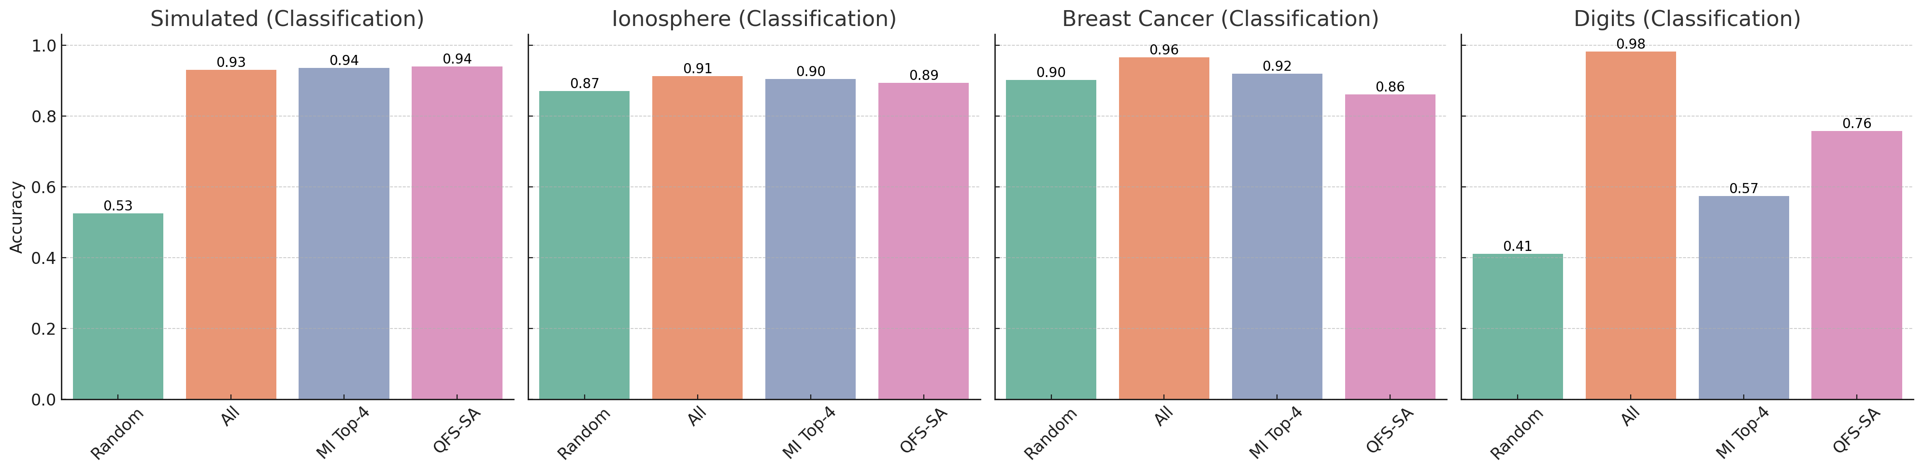
Method
Results
Motivation
Algorithm
Results
Discussion
Benchmark Performance - Classification
Conclusion
QFS consistently outperforms random selection and matches MI-based methods in accuracy, using fewer features (k = 4).
Notes:
Across classification datasets, QFS consistently performs better than random selection, and in most cases matches or slightly outperforms mutual information (MI) based selection.
For example, in the simulated dataset and Ionosphere, QFS-SA achieves nearly the same accuracy as top-4 MI features This shows that QFS can maintain strong accuracy even with a reduced feature set.

Slide 16
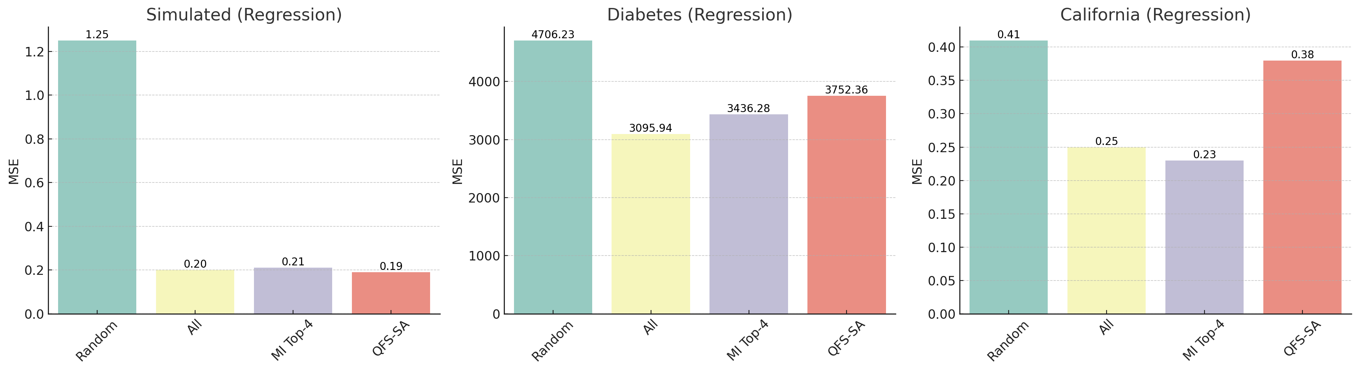
Method
Results
Motivation
Algorithm
Results
Discussion
Benchmark Performance - Regression
Conclusion
Despite slight underperformance compared to full-feature models in some datasets, QFS-SA effectively reduces feature count while maintaining predictive quality.
Notes:
In regression tasks, we see a slight underperformance of QFS compared to full-feature models, particularly on real datasets.
However, QFS still clearly outperforms random selection, and performs competitively with MI ranking.
So it offers a good trade-off: fewer features, still reasonable accuracy.

Slide 17
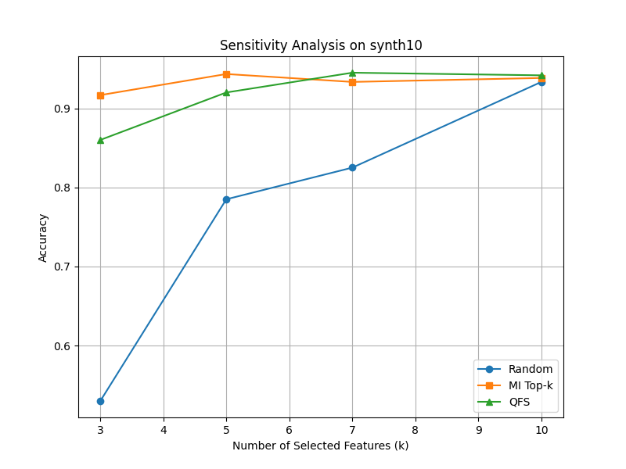
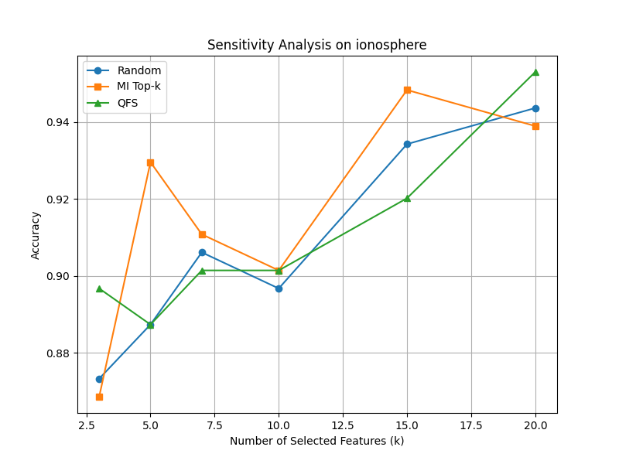
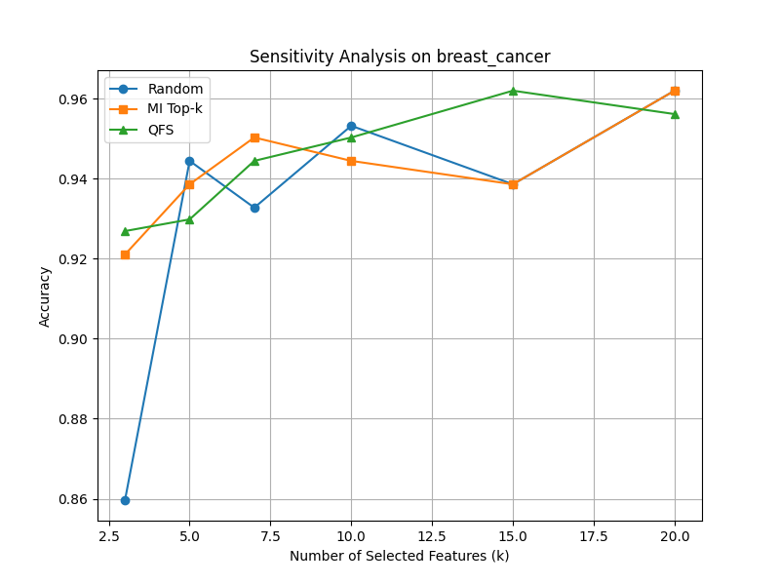
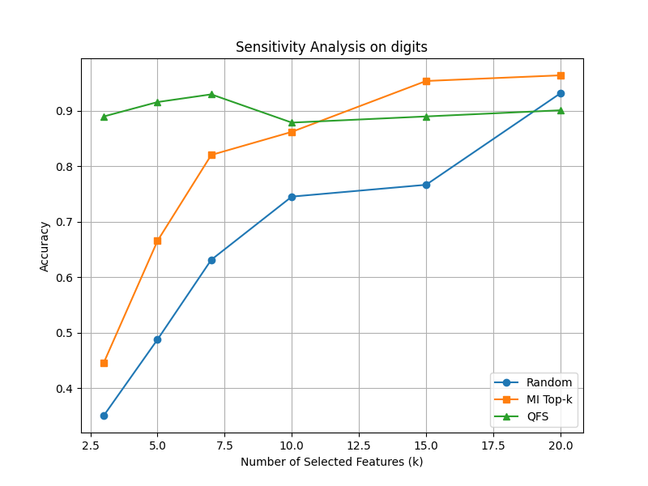
Method
Results
Motivation
Algorithm
Results
Discussion
Feature Quality Analysis – Sensitivity Analysis
QFS shows comparable or superior performance to MI Top-k and Random, with better consistency under varying feature counts.
Conclusion
QFS-SA consistently performs competitively with MI Top-k and Random selection in classification tasks, maintaining high accuracy across different feature counts.
Notes:
Next, I evaluated sensitivity to the number of selected features (k).
Across classification datasets, QFS shows stable and high accuracy, even when k changes. It matches or exceeds MI-based selection in many cases, especially on datasets like Digits or Breast Cancer.

Slide 18
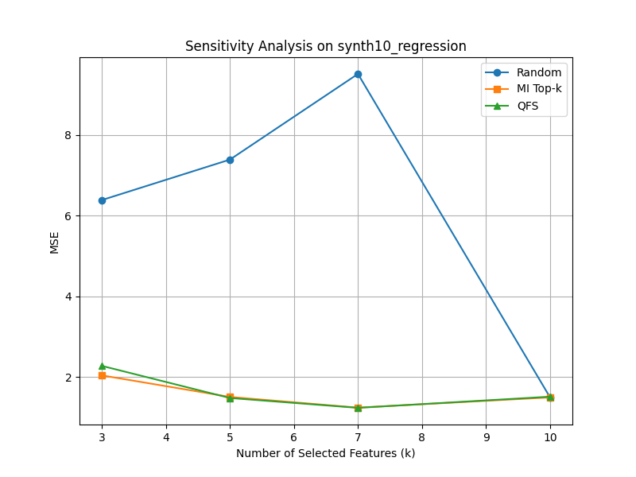
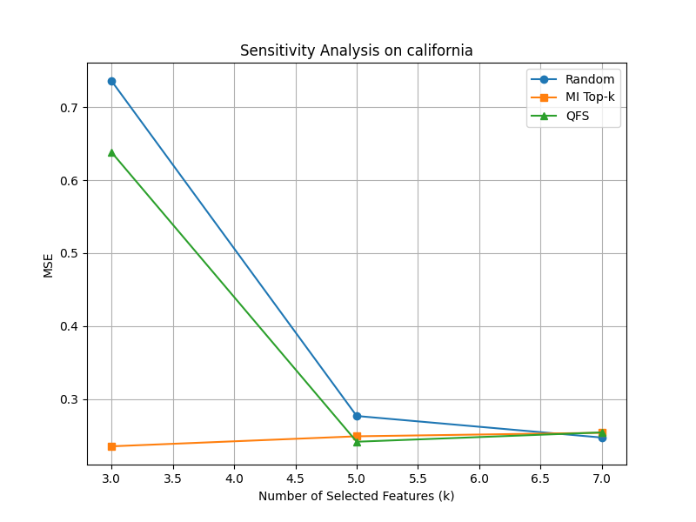
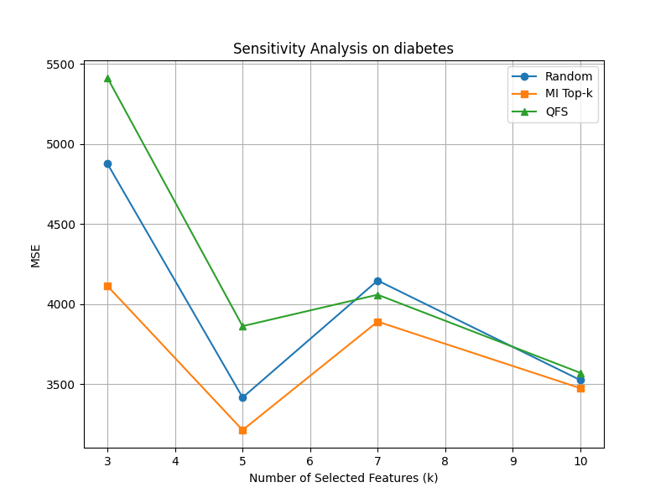
Method
Results
Motivation
Algorithm
Results
Discussion
Feature Quality Analysis – Sensitivity Analysis
Conclusion
While full-feature models may achieve lower error in some regression datasets, QFS-SA offers a strong trade-off between simplicity and performance, often outperforming random selection.
Notes:
In regression tasks, QFS again shows better performance than random selection. provides an efficient alternative under feature count constraints.

Slide 19
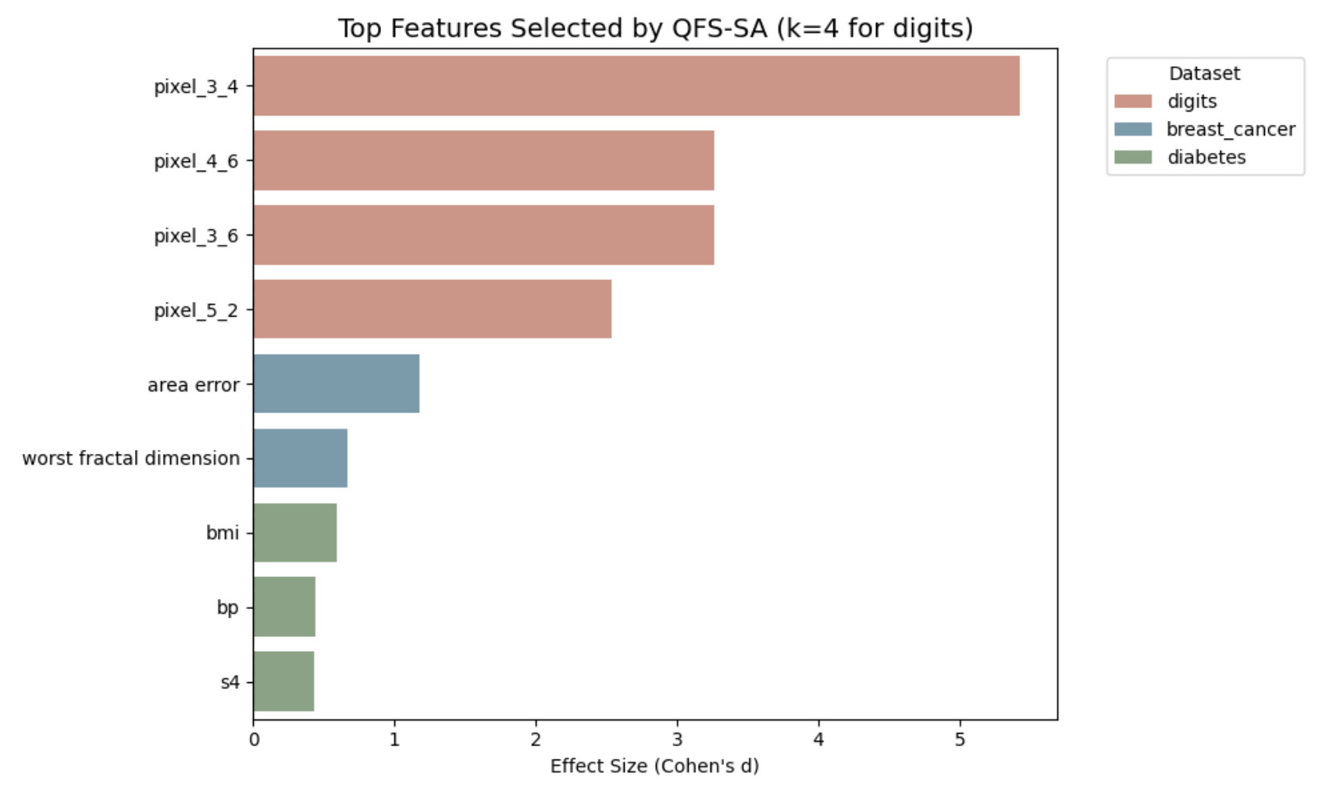
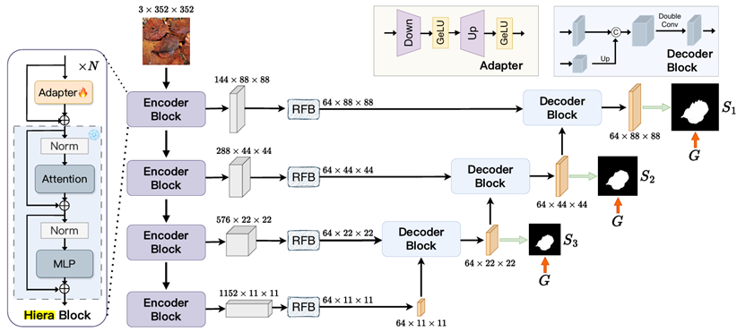
Method
Results
Motivation
Algorithm
Results
Discussion
Feature Quality Analysis – Importance Analysis
Features selected by QFS show large effect sizes, especially in the digits dataset.
Several features achieve Cohen’s d > 2.0, indicating strong discriminative power between classes.
In breast_cancer, the most informative feature (area error) achieves Cohen’s d > 1.0, suggesting a large group difference.
For ionosphere, although effect sizes are lower, selected features still pass significance testing (p < 0.05).
QFS tends to select features that are both statistically significant and practically meaningful.
Notes:
I then tested whether selected features were statistically significant.
In the Digits dataset, many QFS-selected features had Cohen's d above 2.0, indicating very strong group separation. In Breast Cancer, the feature area error also showed a large effect size.
This confirms that QFS can select practically meaningful and discriminative features.

Slide 20
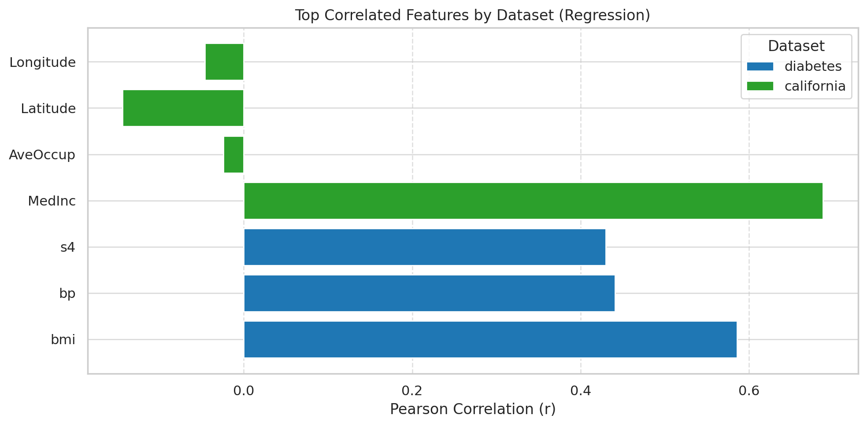
Method
Results
Motivation
Algorithm
Results
Discussion
Feature Quality Analysis – Importance Analysis
MedInc (California Housing) exhibits the strongest positive correlation (r = 0.688) with housing prices.
In the diabetes dataset, BMI, blood pressure (bp), and serum test (s4) are the most predictive features.
All top features are statistically significant (p < 0.01), indicating strong associations with the target.
Negative correlations (e.g., Latitude, Longitude) suggest inverse relationships with housing prices.
QFS successfully identifies interpretable and relevant features with domain relevance (e.g., BMI and disease progression).
Notes:
In regression datasets, selected features such as BMI, blood pressure, and income were highly correlated with the target variable.
All of them passed significance testing (p < 0.01), and matched domain knowledge, showing QFS identifies interpretable patterns.

Slide 21
Motivation
Algorithm
Method
Results
Discussion
VQE Implementation Results
Output Summary
Interpretation Points
Estimated Minimum Energy: −0.1096
Most probable bitstring: 1010111000
Selected features (indices): [3, 4, 5, 7, 9]
Random Forest accuracy: 0.530
QFS-VQE was able to select a sparse feature set of 5 out of 10 features.
The selected features yielded only slightly better than random performance on this simulated task (Accuracy = 0.53).
This suggests either:
the selected bitstring was suboptimal
VQE struggled with convergence under current ansatz/depth.
Notes:
Lastly, I tested the quantum version using VQE.
The output bitstring selected 5 out of 10 features, and achieved 53% accuracy, only slightly better than random.
This suggests that either:
The selected bitstring was suboptimal,
Or the VQE circuit struggled to converge due to shallow ansatz or noise.
There’s still room to improve quantum performance.

Slide 22
Discussion

Slide 23
Motivation
Algorithm
Method
Results
Discussion
Discussion
Key Highlights
1
2
3
4
Strong Predictive Power
Robustness
Interpretability
Quantum Realizability
Consistently matches or outperforms MI Top-k using only k = 4 features
Achieving up to 96% accuracy on classification tasks.
Sensitivity analysis shows stable performance even when varying the number of selected features, indicating reliability.
Selected features show large effect sizes (e.g., Cohen’s d > 2) and statistical significance (p < 0.01), enhancing model transparency.
The implementation successfully recovered a sparse bitstring solution and selected features via quantum optimization
Notes:
In this section, I’d like to highlight four key takeaways from our study.
First, our QFS algorithm achieves strong predictive power, often matching or outperforming mutual information top-k baselines, even with only four features. We reached up to 96% accuracy on classification tasks.
Second, the robustness of our method is evident in the sensitivity analysis—it shows consistent performance even when the number of selected features varies.
Third, we found the selected features are highly interpretable. Many features demonstrated large effect sizes and significant p-values, which helps model transparency.
Finally, we confirmed quantum realizability. Our VQE-based solver was able to produce valid bitstring outputs and recover feature selections from quantum optimization.

Slide 24
Motivation
Algorithm
Method
Results
Discussion
Limitations
Quantum Performance Bottleneck
Simulated Backend Only
Dataset Scale
The current VQE implementation produced only marginal improvement over random feature selection
Indicating convergence or expressibility issues under shallow ansatz.
All quantum evaluations were conducted using simulators. Hardware noise, decoherence, and limited qubit counts were not considered.
Experiments were conducted on small to medium datasets (≤ 64 features). The scalability of QFS on high-dimensional data remains untested.
Future Work
VQE Refinement、Hardware Experiments、Hybrid Methods、Compare with Other Quantum Algorithms
Notes:
However, our work has a few limitations. First, the quantum part currently shows only marginal improvements over random selection. This may be due to convergence or expressibility issues under shallow ansatz.
Second, all quantum evaluations were done using simulators. So we haven’t accounted for hardware noise or decoherence effects yet.
Third, we only tested small to medium-scale datasets—most under 64 features—so scalability to high-dimensional data remains an open question.
In the future, we plan to refine the VQE ansatz, experiment with real hardware, and explore hybrid quantum-classical methods.

Slide 25
Q & A

